Slide 1
Inductive/Recursive Definition

Slide 2
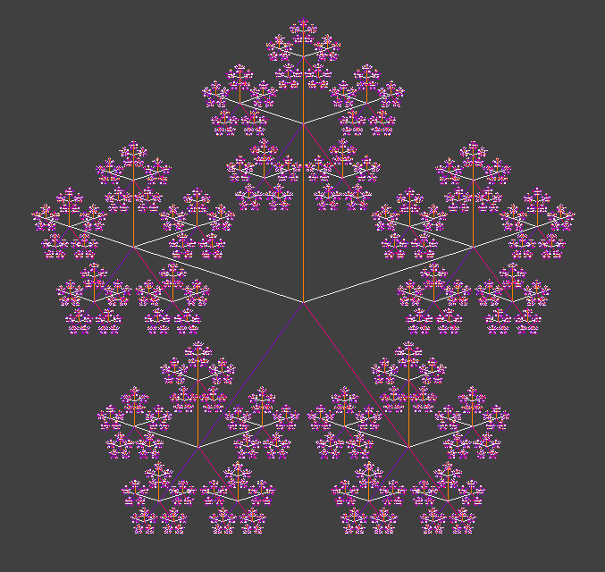
Introduction
Both in nature and in computer science many concepts have a recursive nature
How to define new objects introduced by computer science?
Examples: Trees, lists, grammars
Think recursively!
The whole idea is that we want to define a structure starting from some small ingredients and by specifying a way to combine those ingredients to form larger structures.

Slide 3
Inductively defined sets
Assume a set A={3, 5, 7, 9,…}
One mathematical way to explain A:
A={2K+3 | K ∈ N} (N is the set of natural numbers)
Another way: 3∈A, and x ∈ A → x+2 ∈ A
Starting element: 3
Construction operation x+2
No other element is in the set
Inductive definition is to define a set using other elements in the same set!

Slide 4
How to Define sets Inductively
To define a set S inductively we should provide three things:
Basis: Specify one or more initial values of S.
Induction: Specify one or more rules to construct elements of S from existing elements of S (i.e., from Basis).
Closure: Specify that no other elements are in S (always assumed by default).
The basis elements and the induction rules together are called the constructor.

Slide 5
Numbers: Inductive Definition
Set of Natural numbers is an inductive set
Basic element: 0 ∈ N
Induction: if x ∈ N then x+1 ∈ N
Closure: All elements of N are created only from basis & induction.
Suppose that you want to program the concept (set) of natural numbers for a robot
Why inductive definition is a better choice in this case?

Slide 6
Inductive definition for Strings
We sometimes use inductive definitions without knowing that!
Recall algebraic expressions: if A and B are algebraic, then (A), A+B, A*B, A/B, … is algebraic
Let’s define E as the set of all algebraic expressions!
We can define E inductively:
Basis: If x is a variable or a number, then x ∈ E
Induction: if A ∈ E and B ∈ E, then (A), A+B, A-B, A/B ∈ E
Algebraic expressions form a language!

Slide 7
Inductive string: examples
Provide an inductive definition for language:
S={a, ab, abb, abbb,…}
Basis: a ∈ S
Induction: if x ∈ S then xb ∈ S
This set is equivalent to S={ab^{n}|n ∈ N}
S={ab, aabb, aaabbb, …}
?
S={ε , ab, abab, ababab,…}
?
Notes:
1. Basis: ab ∈ S
Induction: If x ∈ S then axb ∈ S
2. Basis: ε ∈ S
Induction: If x ∈ S then xab ∈ S or abx ∈ S

